Slide 1
REST APIs - REST Web Services
You will learn how to …
• Create REST APIs / Web Services with Spring • Discuss REST concepts, JSON and HTTP messaging • Install REST client tool: Postman • Develop REST APIs / WebServices with @RestController • Build a CRUD interface to the database with Spring REST

Slide 2
Introduction to Spring REST development
Business Problem
• Build a client app that provides the weather report for a city
• Need to get weather data from an external service

Slide 3
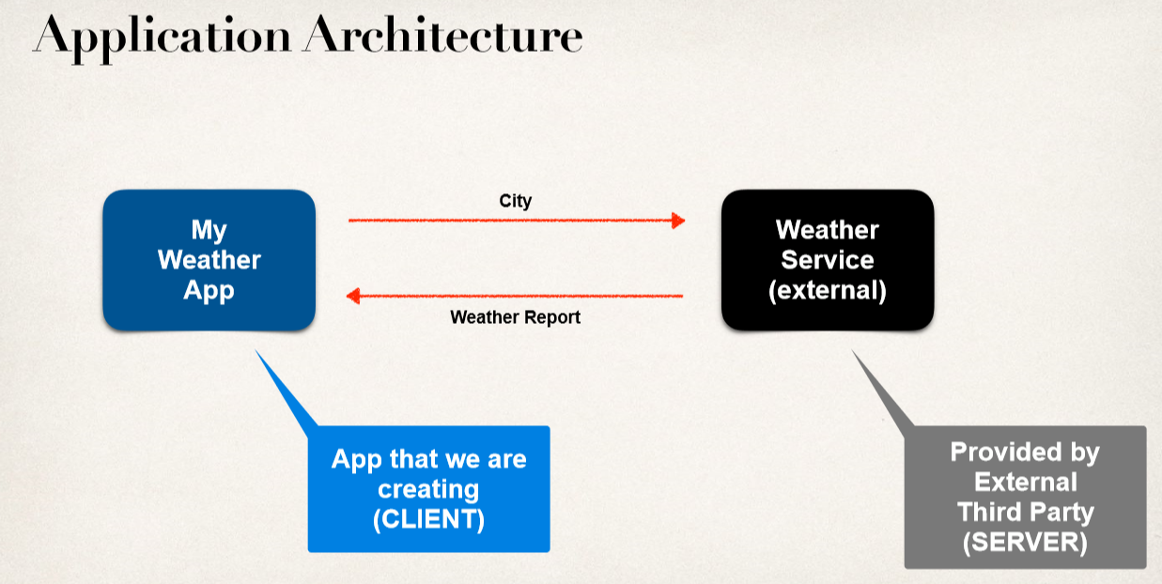

Slide 4
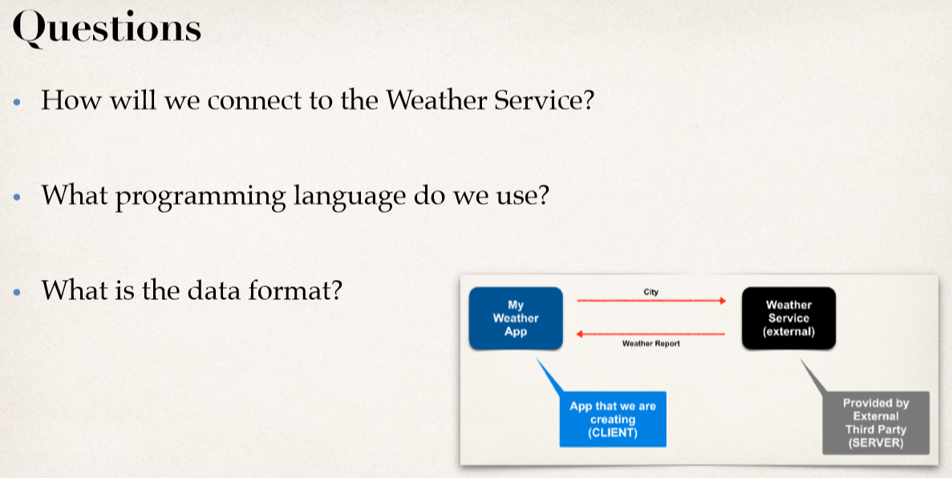

Slide 5
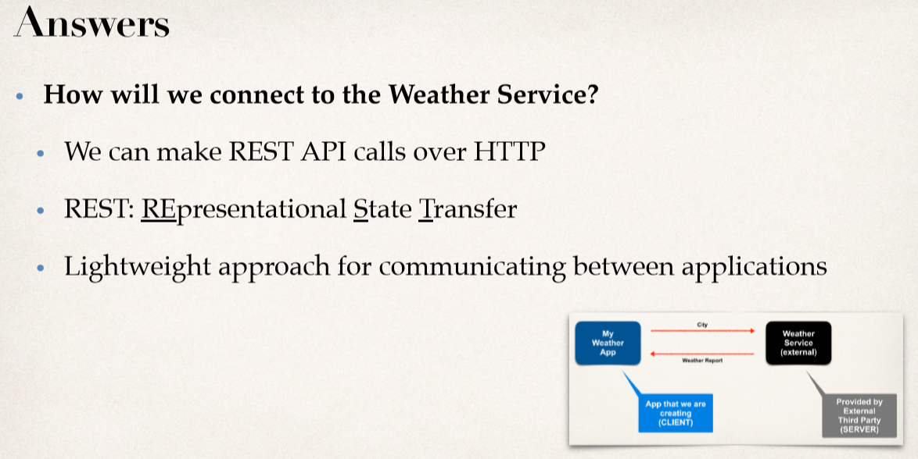

Slide 6
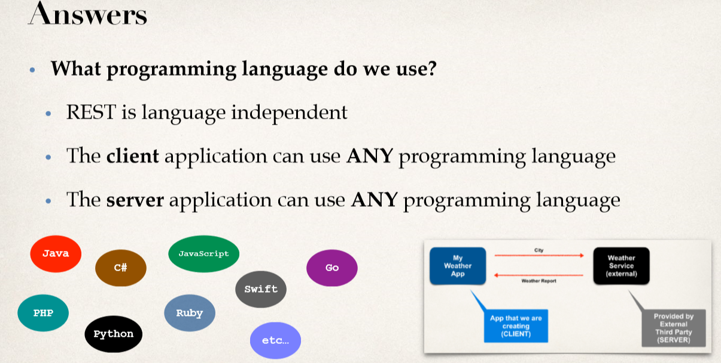

Slide 7
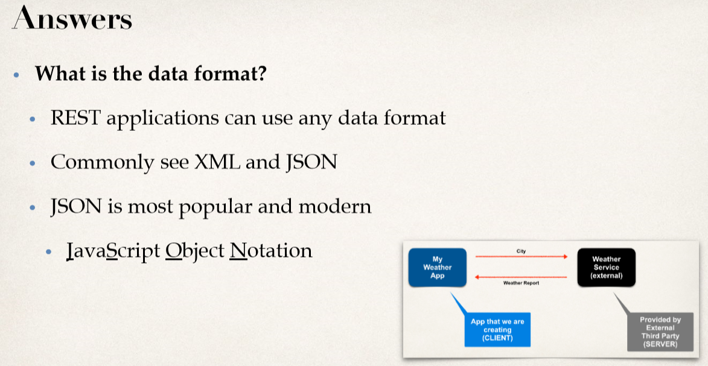

Slide 8
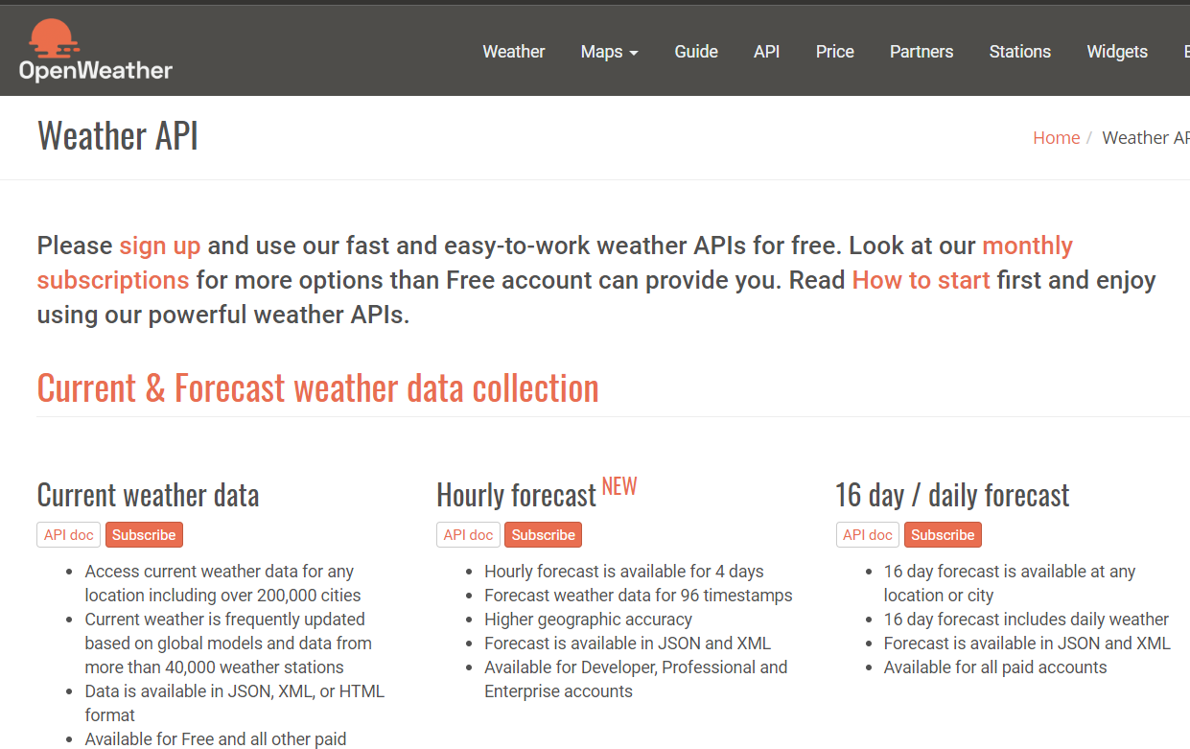
Use free Weather Service provided by: openweathermap.org

Slide 9
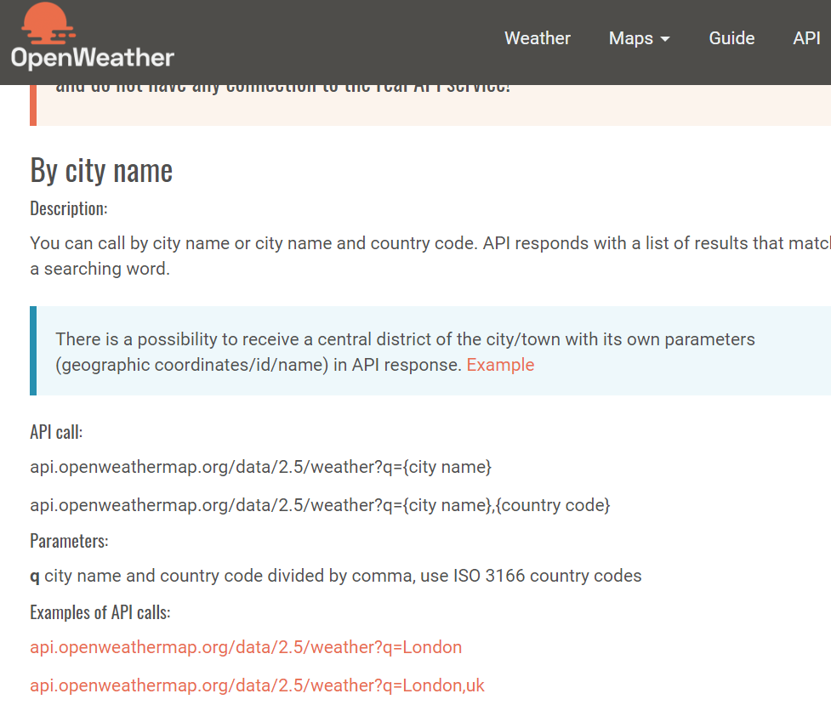

Slide 10
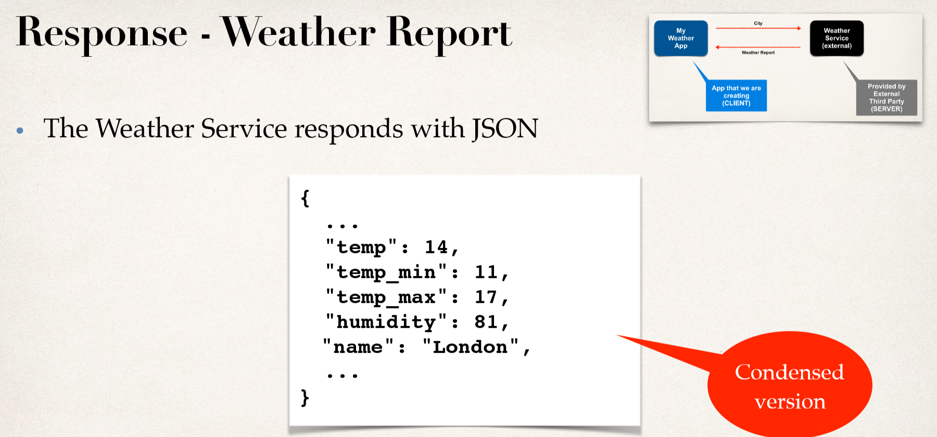

Slide 11
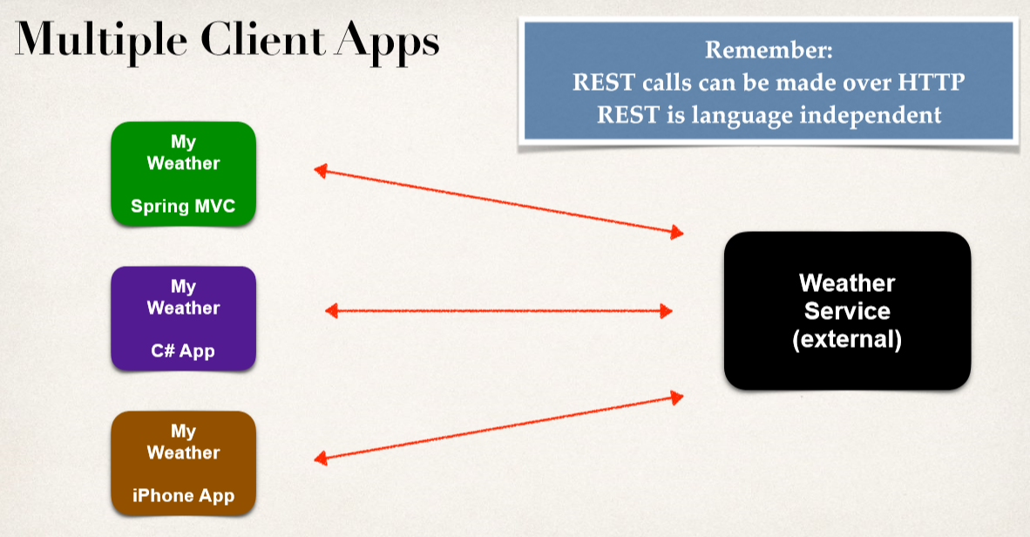

Slide 12
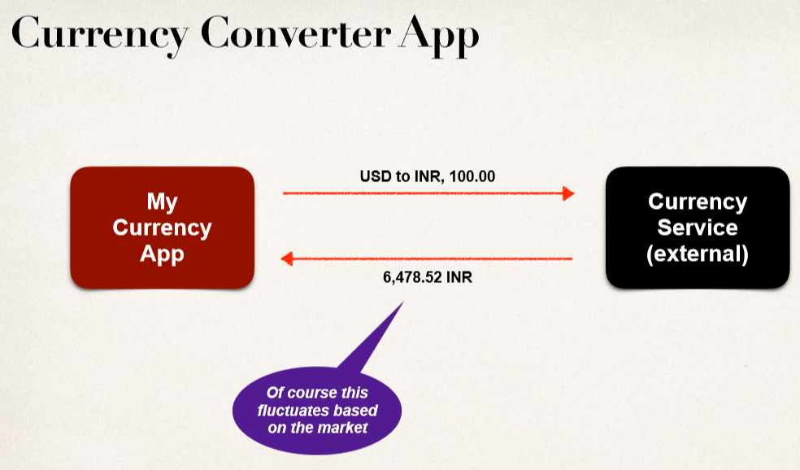

Slide 13
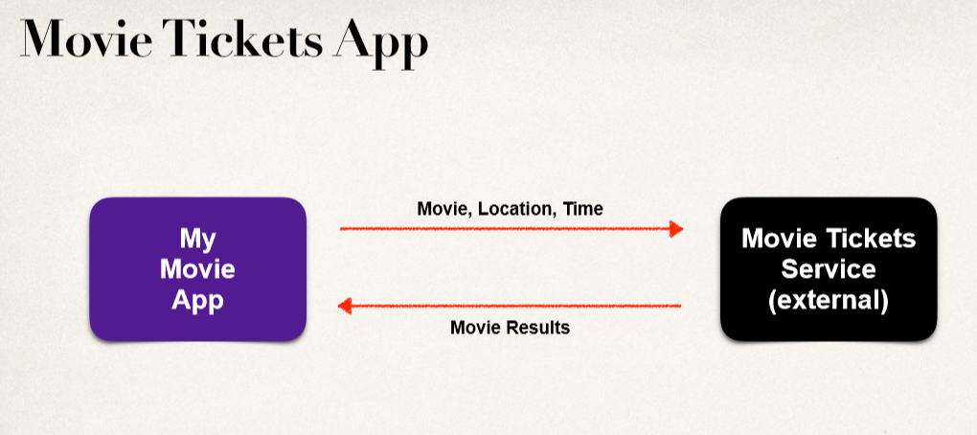

Slide 14
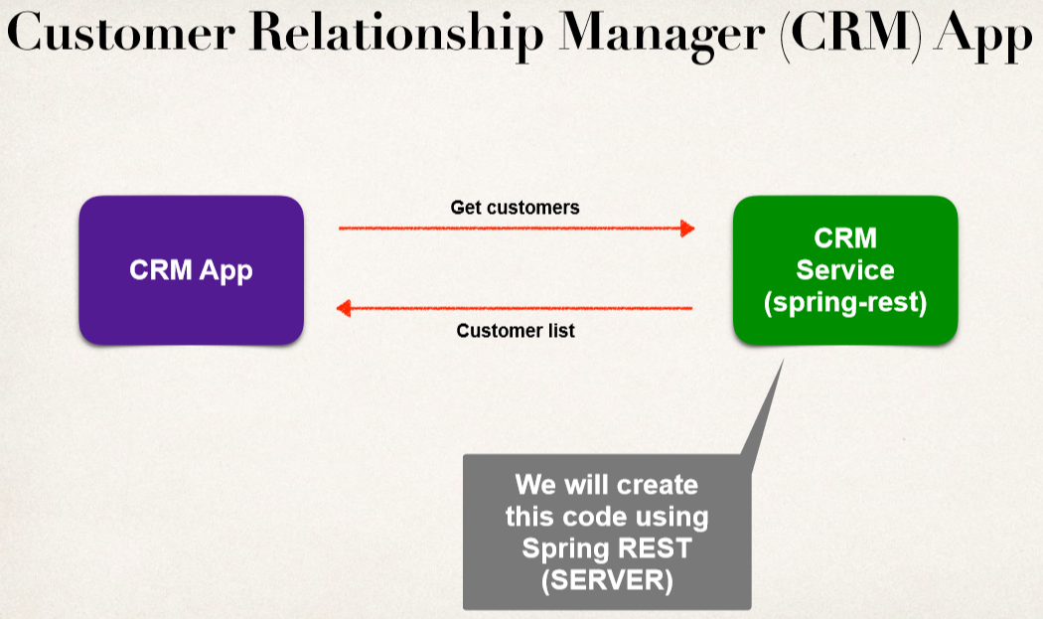

Slide 15
